Slide 1
Lecture 28
Comparing two means

Slide 2
Review
1 What is the pooled proportion?
$\hat{p}=(X_{1}+X_{2})/(n_{1}+n_{2})$: all the successes over all the observations in both samples
2 What are independent samples?
one sample tells us nothing about the other: separate random samples, or randomized groups
3 What are dependent samples?
each value is paired with one in the other sample: the same subjects twice, twins

Slide 3
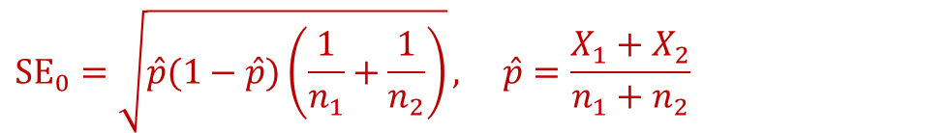
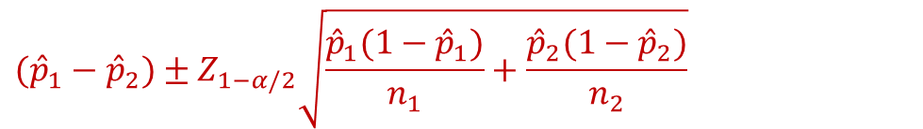


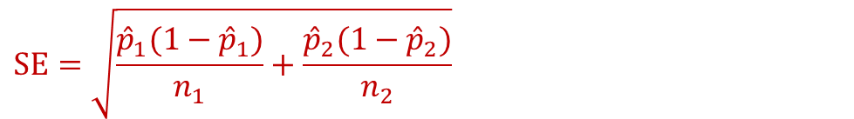

Review: to pool or not? (two proportions)
null hypothesis or goal
the SE we use
pool?
$${SE}_{0}=\sqrt{\hat{p}(1−\hat{p})\left(\frac{1}{n_{1}}+\frac{1}{n_{2}}\right)}, \hat{p}=\frac{X_{1}+X_{2}}{n_{1}+n_{2}}$$
$$H_{0}:p_{1}=p_{2}$$
pooled
$$SE=\sqrt{\frac{{\hat{p}}_{1}(1−{\hat{p}}_{1})}{n_{1}}+\frac{{\hat{p}}_{2}(1−{\hat{p}}_{2})}{n_{2}}}$$
$$H_{0}:p_{1}−p_{2}=d_{0}, d_{0}≠0$$
unpooled
$$({\hat{p}}_{1}−{\hat{p}}_{2})±Z_{1−α/2}\sqrt{\frac{{\hat{p}}_{1}(1−{\hat{p}}_{1})}{n_{1}}+\frac{{\hat{p}}_{2}(1−{\hat{p}}_{2})}{n_{2}}}$$
a $100(1−α)\%$ CI for $p_{1}−p_{2}$
unpooled
pool only when $H_{0}$ says $p_{1}=p_{2}$: then there is one $p$, and both samples estimate it

Slide 4
Two means: the notation
populations 1 and 2
the two groups we compare (for example, girls and boys)
$$μ_{1}, μ_{2}$$
the population means: the parameters
$$σ_{1}, σ_{2}$$
the population standard deviations: almost always unknown
$$n_{1},{\overline{x}}_{1},s_{1}; n_{2},{\overline{x}}_{2},s_{2}$$
the size, mean and standard deviation of each sample
$${\overline{x}}_{1}−{\overline{x}}_{2}$$
the estimate: ${\overline{x}}_{1}−{\overline{x}}_{2}$ estimates $μ_{1}−μ_{2}$

Slide 5
Two means: the hypotheses
$$H_{0}:μ_{1}=μ_{2}$$
the same as $H_{0}:μ_{1}−μ_{2}=0$: no difference between the populations
$$H_{A}:μ_{1}−μ_{2}>0$$
upper-tailed: population 1 has the larger mean
$$H_{A}:μ_{1}−μ_{2}<0$$
lower-tailed: population 1 has the smaller mean
$$H_{A}:μ_{1}−μ_{2}≠0$$
two-sided: a difference in either direction

Slide 6
The sampling distribution of x̄₁ − x̄₂
its center
$μ_{1}−μ_{2}$: on average, the estimate ${\overline{x}}_{1}−{\overline{x}}_{2}$ hits the true difference
its SE: variances add for independent samples
$$SE=\sqrt{\frac{σ_{1}^{2}}{n_{1}}+\frac{σ_{2}^{2}}{n_{2}}}$$
its shape
normal if both populations are normal; approximately normal if both $n≥30$
its distribution: approximately, once $s_{1},s_{2}$ replace $σ_{1},σ_{2}$ in the SE
$$\frac{({\overline{x}}_{1}−{\overline{x}}_{2})−(μ_{1}−μ_{2})}{SE}∼t(min(n_{1}−1, n_{2}−1))$$

Slide 7
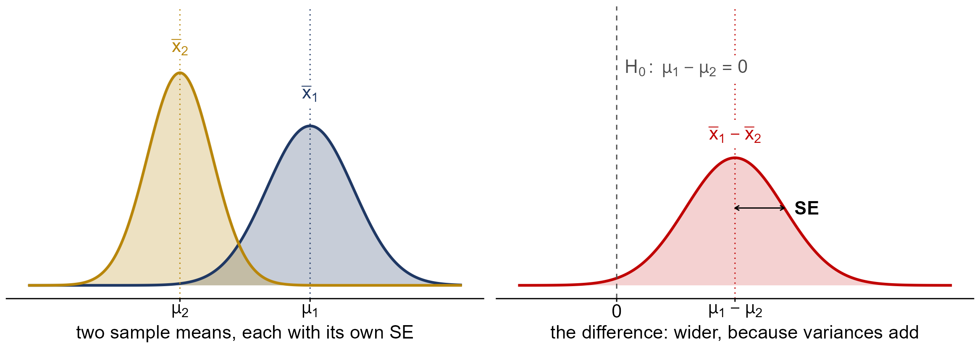
Picturing x̄₁ − x̄₂
${\overline{x}}_{1}−{\overline{x}}_{2}$ is centred at $μ_{1}−μ_{2}$, and more spread out than either mean: the variances add

Slide 8
The two independent samples t-test
$σ_{1},σ_{2}$ unknown
use $s_{1},s_{2}$: $SE=\sqrt{s_{1}^{2}/n_{1}+s_{2}^{2}/n_{2}}$
the test statistic
$$t_{obs}=\frac{({\overline{x}}_{1}−{\overline{x}}_{2})−0}{SE}$$
degrees of freedom
$df≈min(n_{1}−1, n_{2}−1)$: an approximation (next slide)
the P-value
the t-table with that df: the tail(s) $H_{A}$ points to
assumptions
two independent random samples; both populations normal, or both $n≥30$

Slide 9
Degrees of freedom: an approximation
the Welch df (what software uses), with $v_{1}=s_{1}^{2}/n_{1}$, $v_{2}=s_{2}^{2}/n_{2}$
$$df=\frac{(v_{1}+v_{2})^{2}}{v_{1}^{2}/\left(n_{1}−1\right)+v_{2}^{2}/\left(n_{2}−1\right)}$$
in practice, by hand
$df≈min(n_{1}−1, n_{2}−1)$: a quick approximation to the Welch df
why that is safe
it is never larger than the Welch df, so our P-values come out a little too big: conservative
either way, an approximation
$t_{obs}$ only approximately follows a t distribution, even with the Welch df

Slide 10

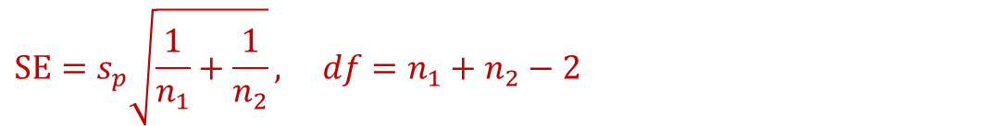
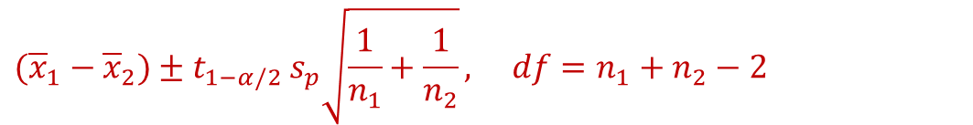


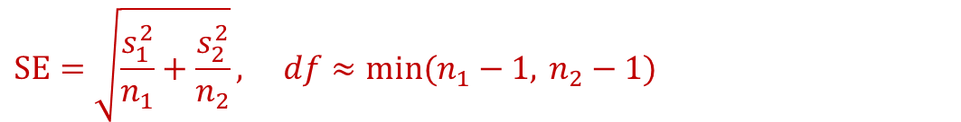
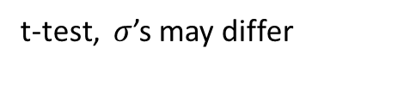
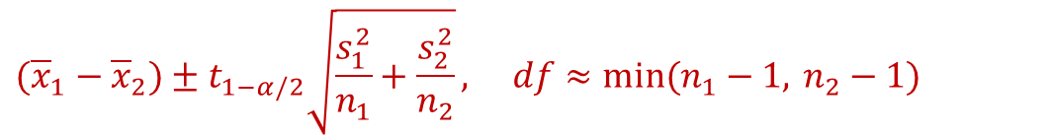
Two means: to pool or not?
test or interval
the SE (and df) we use
pool?
$$SE=s_{p}\sqrt{\frac{1}{n_{1}}+\frac{1}{n_{2}}}, df=n_{1}+n_{2}−2$$
t-test, assume $σ_{1}=σ_{2}$
pooled
$$SE=\sqrt{\frac{s_{1}^{2}}{n_{1}}+\frac{s_{2}^{2}}{n_{2}}}, df≈min(n_{1}−1, n_{2}−1)$$
t-test, $σ$’s may differ
unpooled
$$({\overline{x}}_{1}−{\overline{x}}_{2})±t_{1−α/2} s_{p}\sqrt{\frac{1}{n_{1}}+\frac{1}{n_{2}}}, df=n_{1}+n_{2}−2$$
$100(1−α)\%$ CI, $σ_{1}=σ_{2}$
pooled
$$({\overline{x}}_{1}−{\overline{x}}_{2})±t_{1−α/2}\sqrt{\frac{s_{1}^{2}}{n_{1}}+\frac{s_{2}^{2}}{n_{2}}}, df≈min(n_{1}−1, n_{2}−1)$$
$100(1−α)\%$ CI, may differ
unpooled
$s_{p}^{2}=\left((n_{1}−1)s_{1}^{2}+(n_{2}−1)s_{2}^{2}\right)/\left(n_{1}+n_{2}−2\right)$. Default: unpooled ($H_{0}$ says nothing about $σ$)

Slide 11
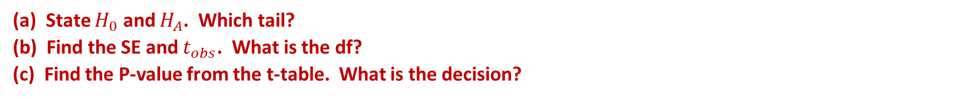
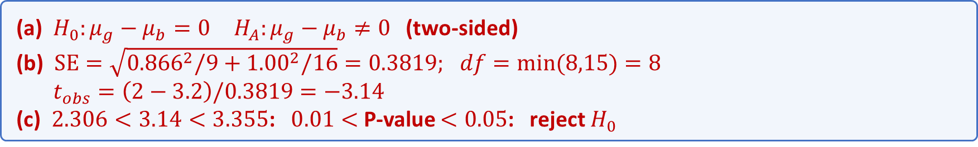
Example: girls, boys and sports
Girls and boys aged 7 to 11 are believed to spend the same average time each day playing sports. A study took a random sample of each; both populations are normal. Is there a difference in the mean time girls and boys spend playing sports each day? (OpenStax, Example 10.1)
girls: $n=9, \overline{x}=2$ hours, $s=0.866$; boys: $n=16, \overline{x}=3.2$ hours, $s=1.00$; $α=0.05$
(a) State $H_{0}$ and $H_{A}$. Which tail?
(b) Find the SE and $t_{obs}$. What is the df?
(c) Find the P-value from the t-table. What is the decision?
(a) $H_{0}:μ_{g}−μ_{b}=0 H_{A}:μ_{g}−μ_{b}≠0$ (two-sided)
(b) $SE=\sqrt{{0.866}^{2}/9+{1.00}^{2}/16}=0.3819; df=min(8,15)=8$
$t_{obs}=\left(2−3.2\right)/0.3819=−3.14$
(c) $2.306<3.14<3.355$: $0.01<$ P-value $<0.05$: reject $H_{0}$

Slide 12
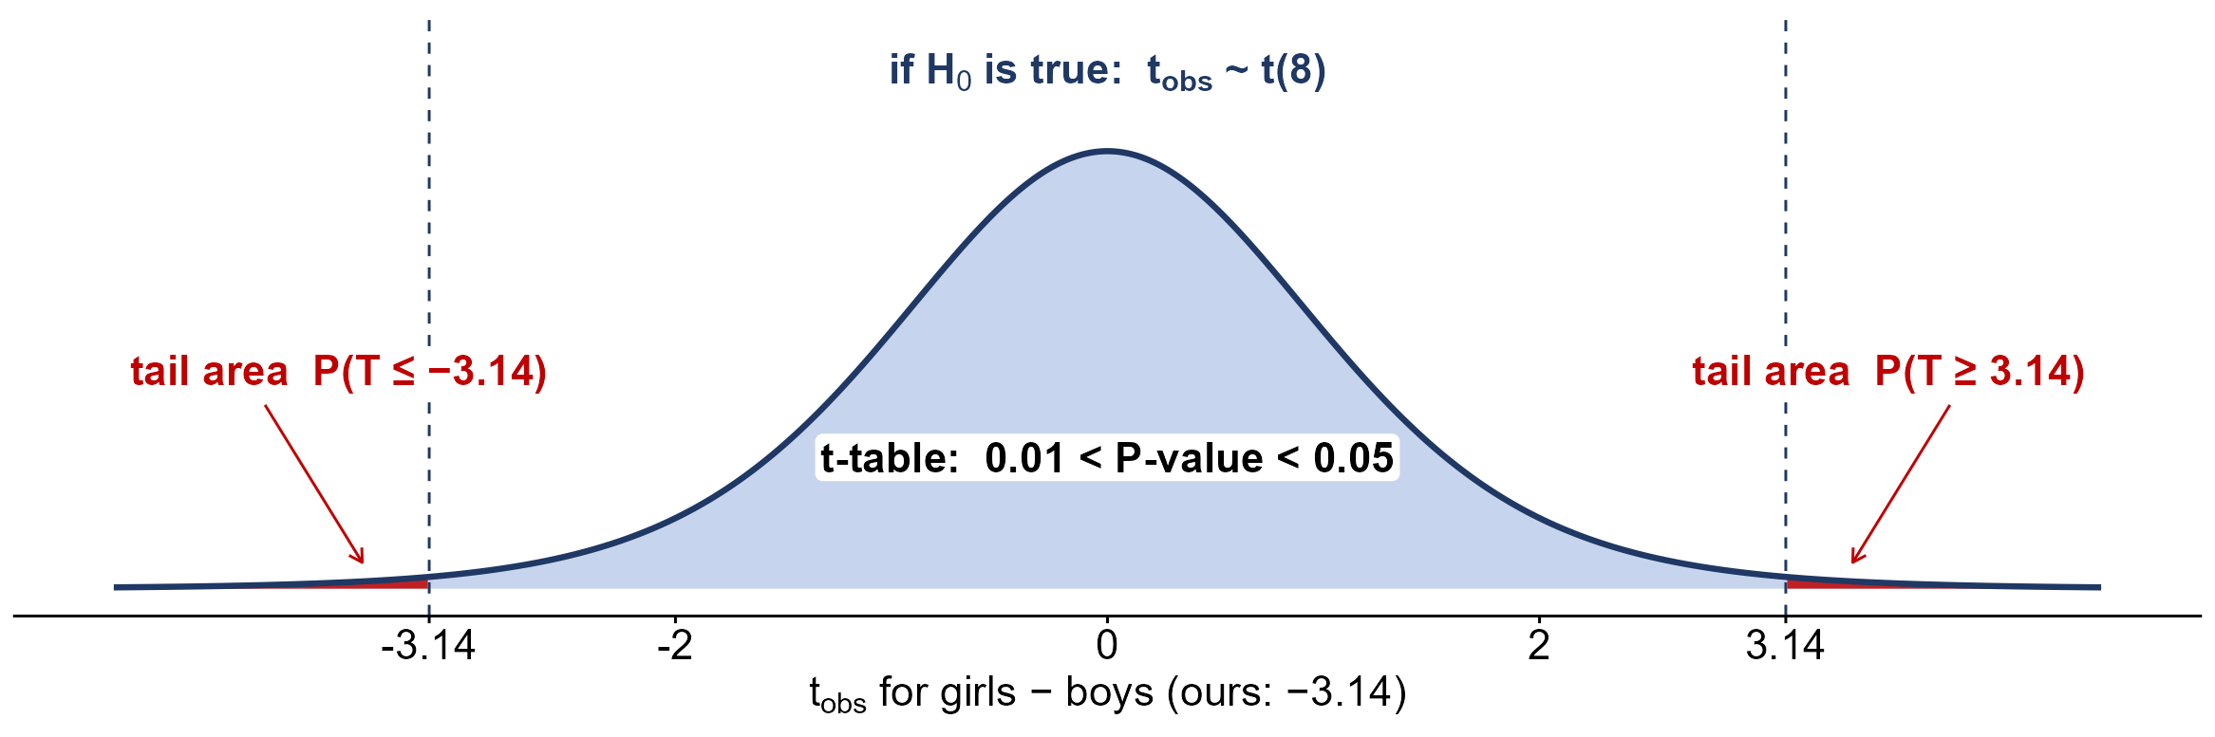
The sports P-value
$0.01<$ P-value $<0.05$ (software: 0.0138): girls and boys differ in mean time playing sports

Slide 13

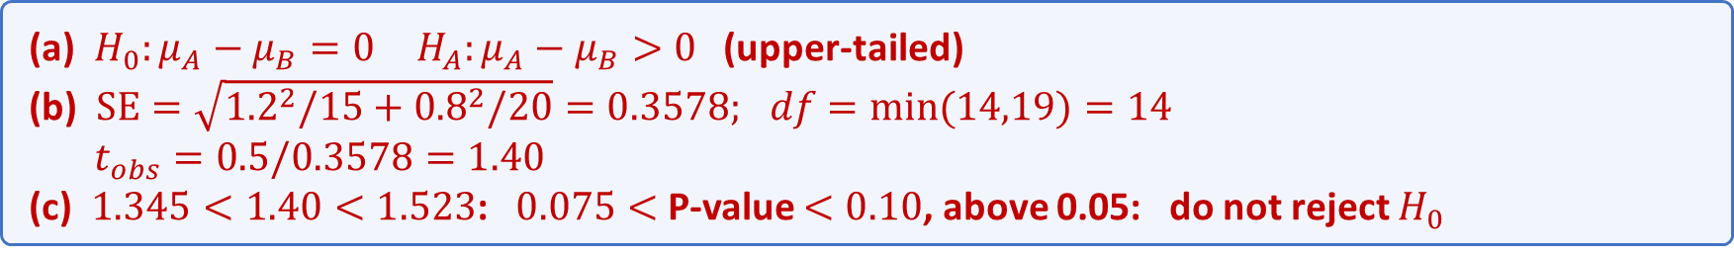
Practice: who keeps workers longer?
A study asks whether Company A keeps its workers longer than Company B. Random samples of workers from each company give each worker’s years with the company; both populations are normal. Does Company A keep its workers longer, on average? (OpenStax, Try It 10.2)
A: $n=15, \overline{x}=5$ years, $s=1.2$; B: $n=20, \overline{x}=4.5$ years, $s=0.8$; $α=0.05$
(a) State $H_{0}$ and $H_{A}$. Which tail?
(b) Find the SE and $t_{obs}$. What is the df?
(c) Find the P-value from the t-table. What is the decision?
(a) $H_{0}:μ_{A}−μ_{B}=0 H_{A}:μ_{A}−μ_{B}>0$ (upper-tailed)
(b) $SE=\sqrt{{1.2}^{2}/15+{0.8}^{2}/20}=0.3578; df=min(14,19)=14$
$t_{obs}=0.5/0.3578=1.40$
(c) $1.345<1.40<1.523$: $0.075<$ P-value $<0.10$, above 0.05: do not reject $H_{0}$

Slide 14
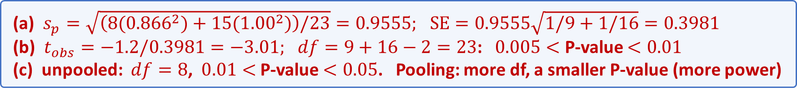
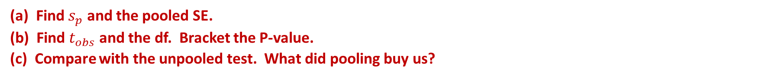
Example: pooling for girls and boys
Back to girls, boys and sports. The two sample SDs are close (0.866 and 1.00), so assuming $σ_{g}=σ_{b}$ is reasonable here. Redo the test with the pooled SD.
girls: $n=9, s=0.866$; boys: $n=16, s=1.00$; ${\overline{x}}_{g}−{\overline{x}}_{b}=−1.2$; $α=0.05$
(a) Find $s_{p}$ and the pooled SE.
(b) Find $t_{obs}$ and the df. Bracket the P-value.
(c) Compare with the unpooled test. What did pooling buy us?
(a) $s_{p}=\sqrt{\left(8({0.866}^{2})+15({1.00}^{2})\right)/23}=0.9555; SE=0.9555\sqrt{1/9+1/16}=0.3981$
(b) $t_{obs}=−1.2/0.3981=−3.01; df=9+16−2=23$: $0.005<$ P-value $<0.01$
(c) unpooled: $df=8$, $0.01<$ P-value $<0.05$. Pooling: more df, a smaller P-value (more power)

Slide 15
Pooling: advantages and disadvantages
when it is reasonable
similar sample SDs (larger / smaller under about 2), similar sample sizes
the advantage
more df ($n_{1}+n_{2}−2$) and an exact t distribution: more power if $σ_{1}=σ_{2}$
the disadvantage
if $σ_{1}≠σ_{2}$ and the $n$'s differ, the Type I error rate is not $α$
for example
$n_{1}=10,σ_{1}=3$ vs $n_{2}=40,σ_{2}=1$: a 5% pooled test rejects a true $H_{0}$ 26% of the time

